Slide 1


MAHARAJA INSTITUTE OF TECHNOLOGY MYSORE
BELAWADI, SRIRANGAPATNA Tq, MANDYA-571477
DEPARTMENT OF COMPUTER SCIENCE & BUSINESS SYSTEM
Academic Year 2026-27
DEPARTMENT OF COMPUTER SCIENCE AND BUSINESS SYSTEMS
MINI PROJECT
PROJECT TITLE FINALIZATION & INITIAL PROPOSAL
Academic Year: 2026–27
Smart Hospital Management System
Guide: Prof. Chaithra S

Slide 2
1. Team Details
Enter complete team information.
Sl. No. | Student Name | USN | Role
1 | Deekshith R | 4MH24CB007 | Member
2 | Jeevan S K | 4MH24CB014 | Member
Guide Name: Prof. Chaithra S
Maharaja Institute of Technology Mysore (MITM) | Department of CSBS | Mini Project 2026–27 2

Slide 3
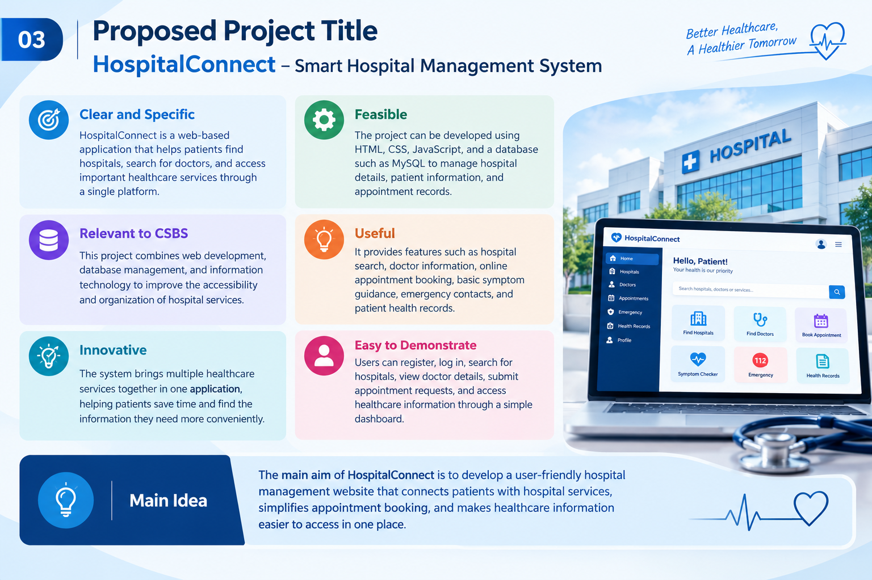

2. Proposed Project Title
PROJECT TITLE
“Smart Hospital Management System”
• Clear and Specific: HospitalConnect is a web-based application that helps patients find
hospitals, search for doctors, and access important healthcare services through a single platform.
• Feasible: The project can be developed using HTML, CSS, JavaScript, and a database such as MySQL to manage hospital details, patient information, and appointment records.
• Relevant to CSBS: This project combines web development, database management, and information technology to improve the accessibility and organization of hospital services.
• Useful: It provides features such as hospital search, doctor information, online appointment booking, basic symptom guidance, emergency contacts, and patient health records.
• Easy to Demonstrate: Users can register, log in, search for hospitals, view doctor details, submit appointment requests, and access healthcare information through a simple dashboard.
Maharaja Institute of Technology Mysore (MITM) | Department of CSBS | Mini Project 2026–27 3

Slide 4
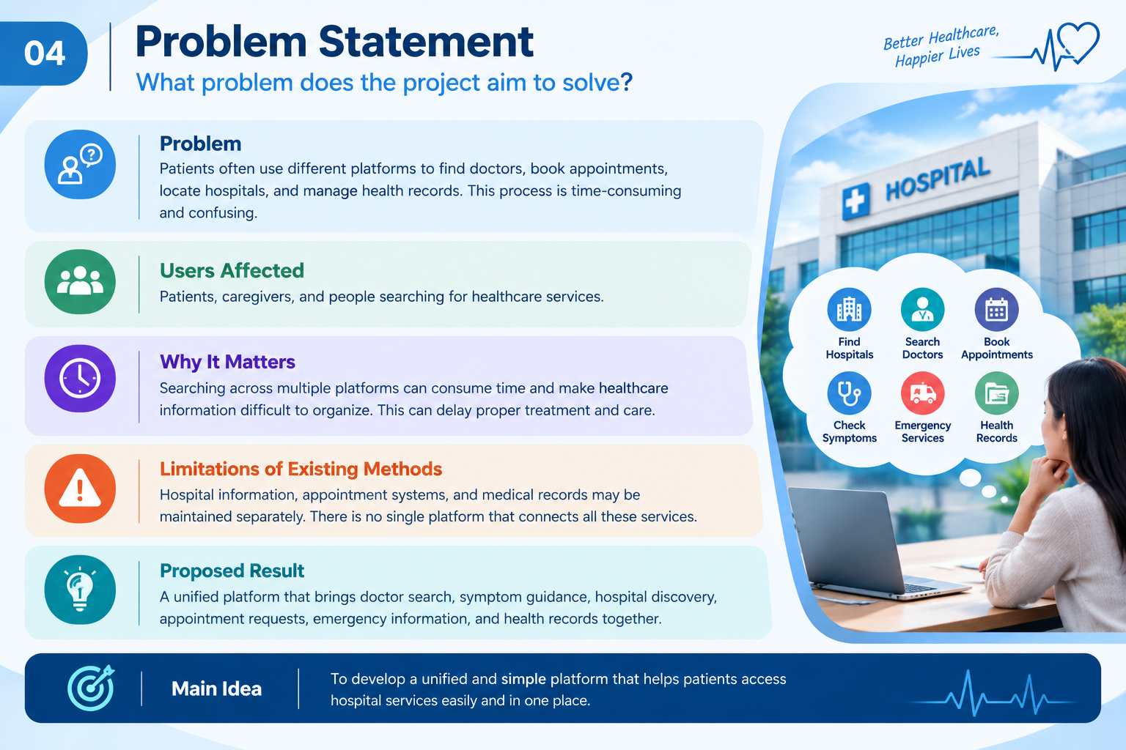
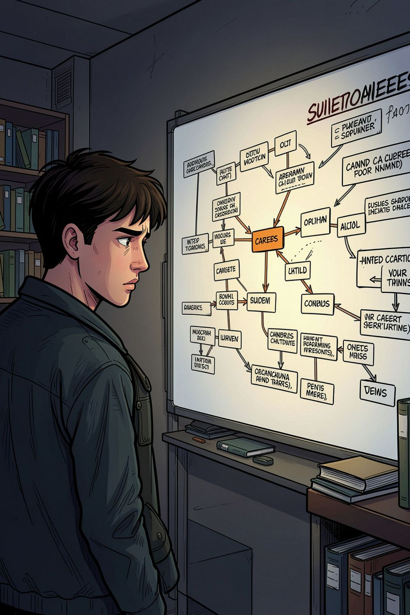
3. Problem Statement
What problem does the project aim to solve?
• Gap: Students often struggle to identify the skills required for their desired career roles and
lack personalized learning guidance.
• users affected: College students, fresh graduates, and job seekers preparing for their careers
• why it matter: Lack of proper career guidance and skill planning can make it difficult for
students to prepare for industry requirements and job opportunities.
• Mention limitations of existing apps: Learning resources, career information, and resume
preparation tools are scattered across multiple platforms, making career preparation
time-consuming and less organized.
•Result: A unified AI-powered platform is needed to provide personalized skill roadmaps, course
recommendations, career exploration, resume building, and ATS checking in one place.
Maharaja Institute of Technology Mysore (MITM) | Department of CSBS | Mini Project 2026–27 4

Slide 5
Literature Survey
Sl. No. | Author & Year | Paper / Study Title | Method / Technology | Key Findings | Research Gap
1 | Peng Zhao et al. (2022) | Web-Based Medical Appointment Systems: A Systematic Review | Online medical appointment systems | Online booking can simplify appointment scheduling and reduce manual work. | Focuses mainly on appointment systems rather than multiple integrated hospital services.
2 | Amir Ahmadi-Javid, Zahra Jalali & Kenneth J. Klassen (2023) | Outpatient Appointment Systems in Healthcare: A Review of Optimization Studies | Appointment scheduling and optimization | Efficient scheduling can improve hospital operations and appointment management. | Focuses mainly on scheduling efficiency rather than a complete patient-facing platform.
3 | Ali Ala & Feng Chen (2024) | Appointment Scheduling Problem in Complexity Systems of the Healthcare Services: A Comprehensive Review | Healthcare appointment scheduling | Highlights the complexity of healthcare scheduling and the need for effective methods. | Focuses on scheduling problems rather than combining several healthcare services
4 | Dr. Sachi Rana & Santosh (2024) | Different Modules of Hospital Management Systems in India | Hospital management modules and digitalization | Digital systems can help organize hospital activities and patient information. | Focuses on hospital management modules rather than a unified patient-facing platform.

Slide 6
4. Objectives
State specific and measurable objectives.
Hospital Search: To help patients find hospitals and access hospital information easily.
Doctor Information: To provide doctor details, specializations, and available services.
Online Appointment Booking: To simplify the appointment request process and reduce manual work.
Emergency and Symptom Guidance: To provide basic symptom information and emergency contact details.
Patient Health Records: To help users organize their health information and access multiple healthcare services through one platform.
Maharaja Institute of Technology Mysore (MITM) | Department of CSBS | Mini Project 2026–27 5

Slide 7
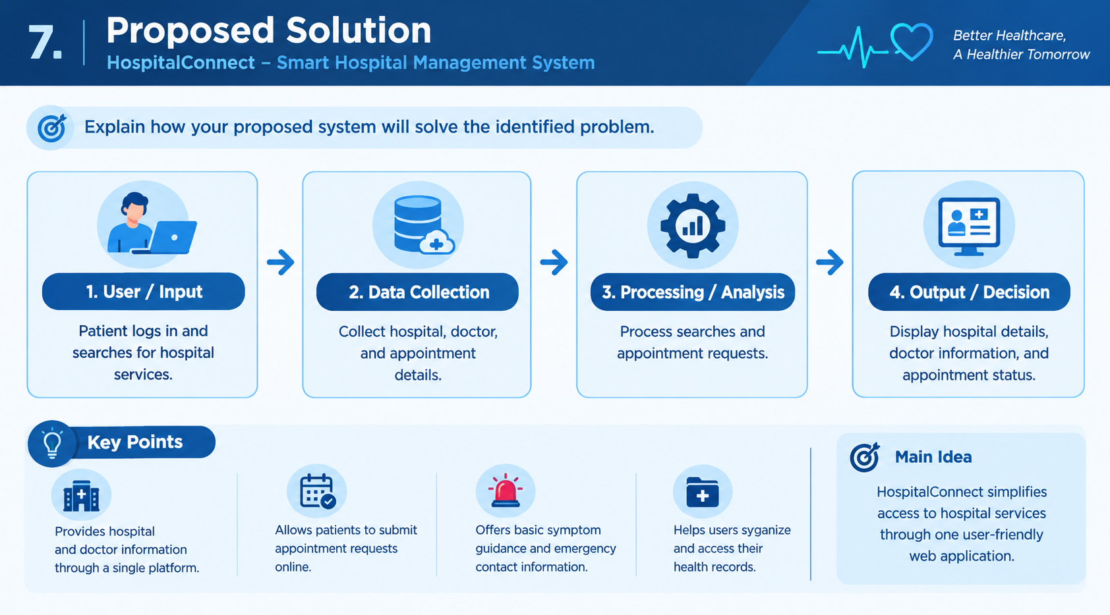
5. Proposed Solution
Explain how your proposed system / study will solve the identified problem.
User / Input
profile, interests, skills, resume
Data Collection
courses and learning resources
Processing / Analysis
Skill matching, course
Output / Decision
→
→
→
• Main idea: Develop an AI-powered platform that helps students plan their skill development and career preparation in one place.
• The system matches students' skills and career goals to provide relevant learning resources and a structured skill roadmap.
• Architecture : A unified platform that simplifies career exploration, skill development and job preparation through personalized guidance and organized learning resources.
Maharaja Institute of Technology Mysore (MITM) | Department of CSBS | Mini Project 2026–27 6

Slide 8
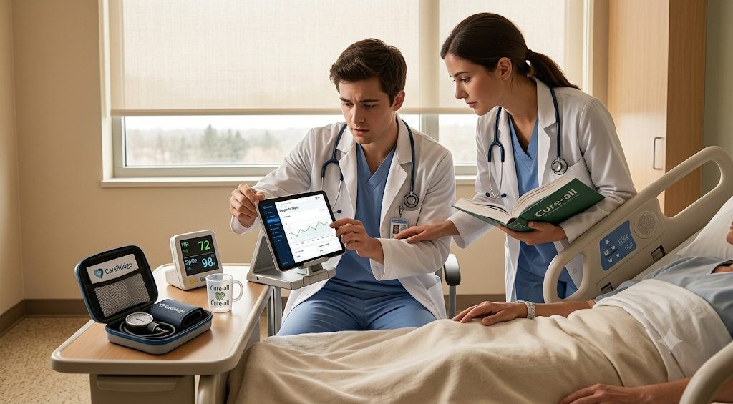

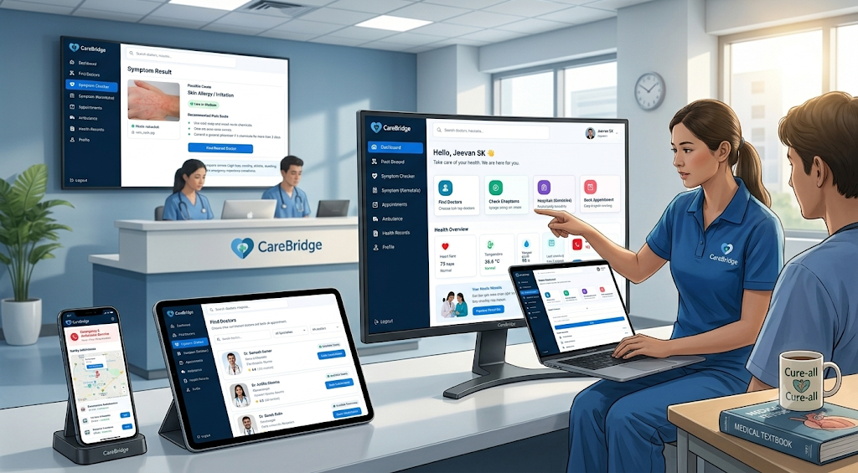
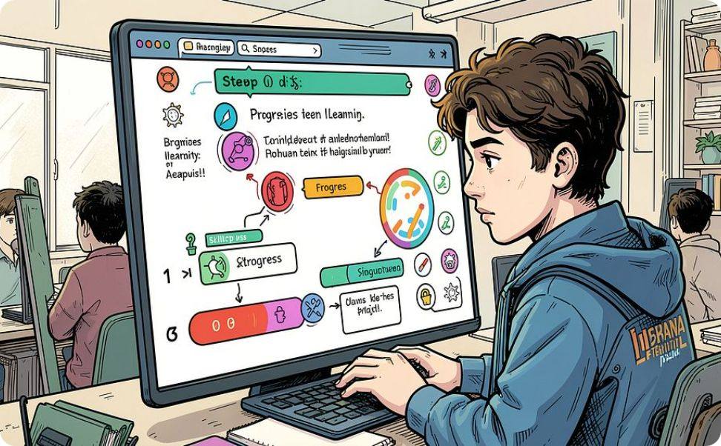
6. Key Features / Modules
List the major functional or analytical modules.
1. Patient Registration and Dashboard
2. Find Doctors
3. Symptom Checker
4. Find Nearest Hospitals
5. Appointment Booking
.
6. Emergency and Ambulance Services
Maharaja Institute of Technology Mysore (MITM) | Department of CSBS | Mini Project 2026–27 7

Slide 9
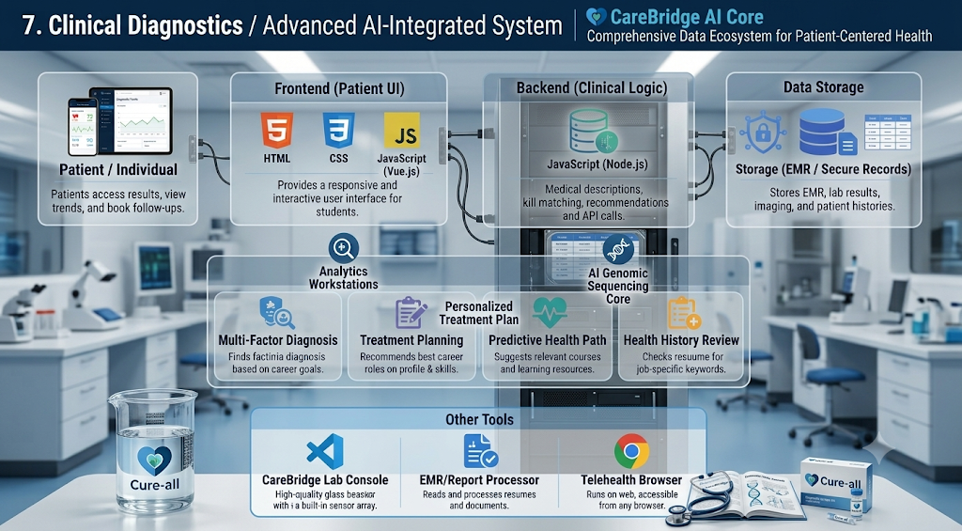
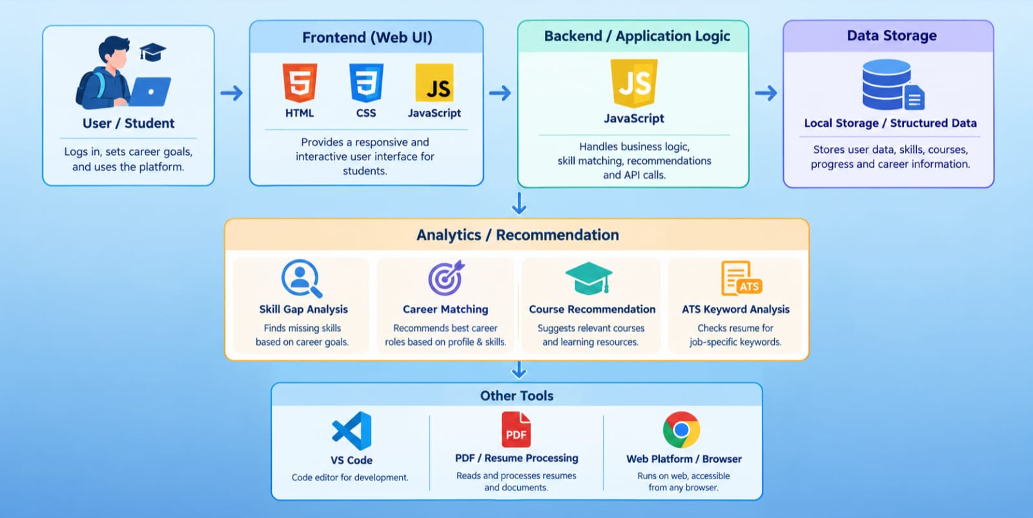
7. Technology / Tools Required
• Frontend: Interactive and responsive user interface for career exploration, skill development, course recommendations, and resume management.(Html,css)
• Backend: JavaScript (Client-side and in Html )
• Database: Local data storage for maintaining student profiles, career information, course details, and learning progress records.
• Framework / Platform: Web-based application platform designed to provide an accessible and user-friendly career guidance experience.
• Analytics / ML / Visualization tools: Skill-gap analysis, career-role matching, course recommendation techniques, ATS keyword analysis, and visual learning progress tracking.
• Other tools: PDF resume processing, document parsing, resume generation, and CSV-based data export utilities.
Mention only the technologies you actually plan to use.
Maharaja Institute of Technology Mysore (MITM) | Department of CSBS | Mini Project 2026–27 8

Slide 10
8. Dataset / Data Source
• Doctor records: Doctor name, specialization, hospital, availability, and contact details.
• Hospital records: Hospital name, address, location, specialties, and contact information.
• Patient records: Basic profile details and authorized health information.
• Appointment records: Doctor, appointment date, time, reason for visit, and booking status.
• Health records: Medical history and uploaded reports, when supported.
• Emergency information: Verified emergency numbers and ambulance service details.
Maharaja Institute of Technology Mysore (MITM) | Department of CSBS | Mini Project 2026–27 9

Slide 11
9. Expected Outcome
What will the project finally deliver?
• Working application: A single interface for patients to access healthcare services.
• Doctor directory: Users can browse doctors and their specialties.
• Appointment management: Users can submit booking requests and view their status.
• Hospital locator: Users can find hospitals and access location information.
• Health record management: Users can view or organize supported medical records.
• Symptom information: Users receive preliminary guidance with clear medical safety warnings.
• Emergency assistance: Users can access emergency contact information quickly.
Maharaja Institute of Technology Mysore (MITM) | Department of CSBS | Mini Project 2026–27 10

Slide 12
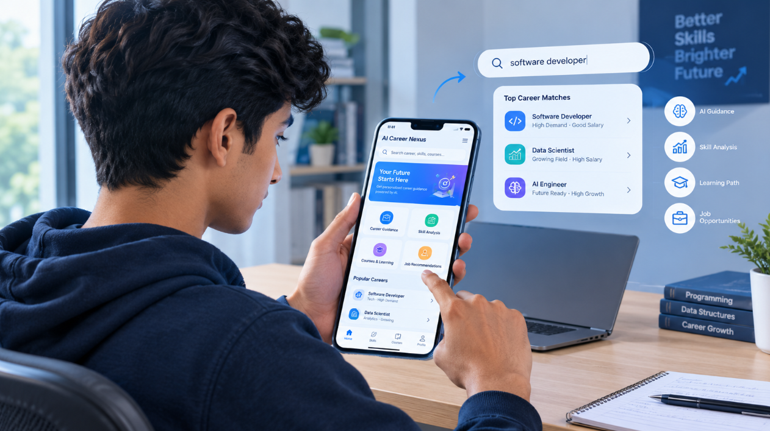
10. Future Scope
• Mobile Application: Develop an Android and iOS application for easy access to hospital services.
• AI-Based Assistance: Integrate AI to provide preliminary symptom analysis and healthcare guidance.
• Online Consultation: Enable patients to consult doctors through secure video calls.
• Digital Prescriptions: Allow doctors to create and manage digital prescriptions.
• Cloud Deployment: Store patient records securely and provide access to authorized users.
• Multilingual Support: Provide Kannada, English, and other language options for better accessibility.
Thank You
Maharaja Institute of Technology Mysore (MITM) | Department of CSBS | Mini Project 2026–27 11

